Slide 1


Body Worn Cameras and
Public Services in Scotland
Scottish Privacy Forum
24 November 2015
William Webster and Charles Leleux,
CRISP, University of Stirling
www.stir.ac.uk/management
http://www.crisp-surveillance.com
@CrispSurv

Slide 2
Structure of Presentation
Terminology: What is body-worn video (BWV)?
Background: Rise is use of body-worn video
Policy context and legislative framework
Research methodology
Discussion and conclusions

Slide 3
Body-Worn Cameras: Initial Questions
What do we mean by the term body-worn video (BWV)?
How are these cameras being used in a public service environment?
How many cameras have diffused?
How are they regulated?
What are the policy and governance issues emerging around the use of BWV?
Do BWV systems raise new privacy concerns?
How does BWV influence relations between service providers and service users?
Are there issues associated with work-place surveillance?

Slide 4
What is Body-Worn Video?
Small cameras worn on the body by ‘front line’ public service providers. Usually affixed to a uniform in standardised location
Records visual (and often audio) interaction between citizens and public service officials
Usually an overt ‘warning’ that CCTV is in progress
Recordings may be used in criminal cases
They are primarily seen as a form of ‘personal protective equipment’
Data usually stored on the device and downloaded at the end of a ‘shift’

Slide 5
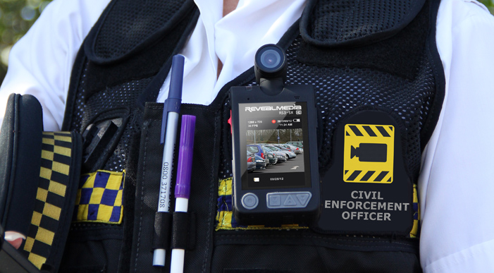
Body-Worn Video 1

Slide 6
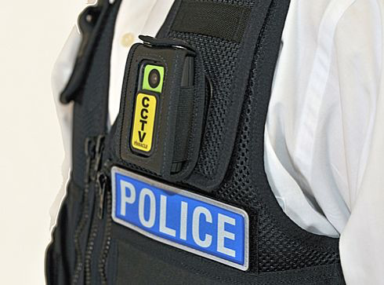
Body-Worn Video 2

Slide 7
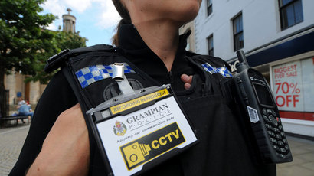
Body-Worn Video 3

Slide 8
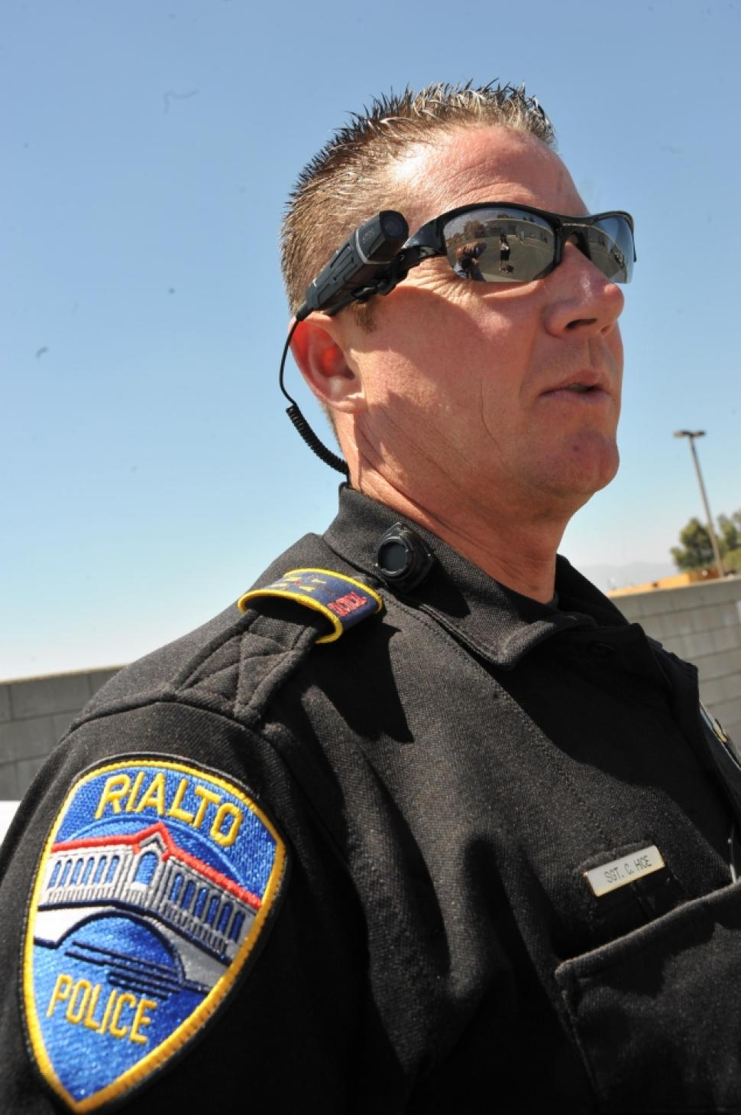
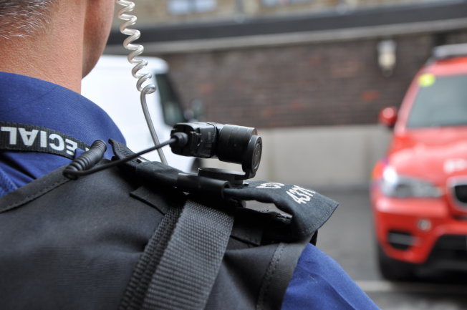
Body-Worn Video 4

Slide 9
Arguments for Body-Worn Video
Protects public service staff from assault
Provides evidence of incidents and interaction with citizens/service users
Reduces time spent investigating complaints
Useful response to anti-social issues: vandalism, graffiti, littering, drug-use, illegal parking, violence
Increasing public expectation for Police to wear BWV
Natural ‘creep’ from policing to alternative public service environments and from CCTV to the person

Slide 10
Policy Context
First trials by police – Plymouth 2006 and Aberdeen/Renfrewshire 2008
Anecdotal evidence of reductions in crime and assault
Limited and robust academic research
Supported by central and local government
High profile cases (e.g. killing of Mark Duggan) have led to calls for UK Police to wear BWV
Increasing roll-out in a range of public service environments: police, railways, NHS, car parking management, warden service, community safety

Slide 11
Regulatory Framework
Protection of Freedoms Act 2012
(Code of Practice on Surveillance Camera Systems)
Surveillance Camera Commissioner
Regulation of Investigatory Powers Act 2000
Data Protection Act 1998
National Strategy for Public Space CCTV in Scotland 2011
Digital Strategy for Justice in Scotland 2014
ICO Code of Practice: ‘In the picture: A data protection code of practice for surveillance cameras and personal information’

Slide 12
Research Approach
Use of BWV in public service contexts in Scotland
Literature review: academic, policy/practitioner materials
Media coverage in UK and US
Comparative analytical framework
4 case studies: police, car parking, railways and warden service (community safety)
Interviews (4) with practitioners from each case study
Anonymity
Site visits and technology demonstrations

Slide 13
Analytical Framework
Dimension | Case Study 1,2,3,4
Historical development – diffusion, costs, context, etc.
The purpose of systems – perceived uses and benefits
Technical specifications/capability - standards
How they are used – how they are integrated into existing services, practical issues
Governance arrangements – policy, oversight, CoP, training
Data management processes – how personal data is handled
How they are experienced – by operatives and surveyed

Slide 14
Case Study 1: Policing
Piloted 2008 in Johnstone/Aberdeen, 30/40 devices
Extended to Aberdeenshire, now over 300 devices
Switched on when attending a call – person(s) advised
Very positive feedback from officers and public
BWV associated with improved detection rates, less time spent in court and dealing with complaints
Early guilty pleas leading to a significant reduction in costs
Appears to moderate behaviour - interacting with police
Use is discretionary, may not be switched on and may raise expectations
Governance, and data processing procedures in place

Slide 15
Case Study 2: Car Parking
Commenced 2012 covering entire Council area
14 devices, switched on continuously, downloads by supervisor onto secure server at the end of each shift
Retention periods for evidential/non-evidential use
Initial apprehension, now seen as part of PPE
Anecdotal evidence of changing relations between staff and citizens
Number of incidents reduced – convictions have been secured
If they break down, attendants must work in pairs
Governance, and data processing procedures in place

Slide 16
Case Study 3: Public Transport
Commenced 2015, Scotland-wide.
Anecdotal evidence that BWV reduced assaults
21 devices, switched on when a situation occurs
Downloads by supervisor to secure server at end of shift
Retention periods for evidential/non-evidential use
Mixed reactions from staff, uptake not as great as expected and trade union concerns
Staff felt safer, and reactions to them by known offenders improved when BWV was being worn
Staff perception that it is a management tool
Governance, and data processing arrangements unclear

Slide 17
Case Study 4: Warden Service
Commenced 2008, whole Council area, 30 devices
Discretionary use, Public advised when switched on
Defined retention periods, secure downloads
Initial fears that it was a ‘tool’ for management
Provides extra security when working late
Some counter-reaction by public filming back with mobiles
Provides proof of events, resolves complaints
Units are expensive £500-£600.
Anecdotal evidence that discretion is required by Warden or situation could be inflamed with BWV
Governance, and data processing arrangements unclear

Slide 18
BWV: Divergent Practices
Evident that a range of practices have emerged around BWV:
Different retention periods
Different technical specifications and capabilities
Different levels of surveillance - when devices are operating
Different perceptions of who is being surveyed - employee and/or service user
Different formal arrangements for governing practice and use – e.g. existence of a Code of Practice
Different arrangements for access to footage
Different levels of training for managers and staff

Slide 19
Discussion
BWV diffusing into a range of public service contexts
Calls in US/UK for Police to be routinely equipped with BWV
Use of BWV becoming normalised in encounters between citizens/public officials
Anecdotal evidence of changing behaviour between surveyor and surveyed (including employer and employee)
A new dimension in citizen-state relations?
Diffusion of BWV not accompanied by clear guidelines covering use or oversight
Differing practices to data management and deployment
Reminiscent of initial diffusion of CCTV in mid 1990’s

Slide 20
References
Data Protection Act 1998
ELLIS, T., JENKINS, C. and SMITH, P., 2015. Evaluation of the introduction of personal issue body worn video cameras (Operation Hyperion) on the Isle of Wight: final report to Hampshire Constabulary.
HOME OFFICE and the POLICE and CRIME STANDARDS DIRECTORATE, 2007. ‘Guidance for the Police use of Body-Worn Devices’, July, 2007
PROTECTION OF FREEDOMS ACT, 2012. Ch.1 S.29 (2), (3).
REGULATION OF INVESTIGATORY POWERS ACT 2000
THE DIGITAL STRATEGY FOR JUSTICE IN SCOTLAND, 2014.
THE SCOTTISH GOVERNMENT, 2011. National Strategy for Public Space CCTV in Scotland, 18.3.11, 19.4
ICO Code of Practice 2015: ‘In the picture: A data protection code of practice for surveillance cameras and personal information’

