Slide 1
An Exploratory
Study Of Fairness Perceptions
In Supply Chain Relationships
Adegboyega Oyedijo, Ying Yang, Chris Hicks, Jingxin Dong
Notes:
PRESENTATION TITLE SLIDE
A selection of different background types are available under the slide layout feature in the ‘Home’ ribbon.
The presentation title should size 44 Arial

Slide 2
‘‘As a firm established to make profit, how can you be in a relationship where fairness (or justice) is absent or not valued by other members of the supply chain?’’ (Purchasing Manager)

Slide 3
Introduction
This matter is ever more becoming a concern for business to business relationships within the supply chain.
Today’s competitive environment has increased the importance of building and maintaining effective business relationships (Johnston et al., 2004).
The fundamental assumption of SCM is that long-lasting relationships between chain members can provide significant opportunities for gaining competitive advantage (Palmatier et al., 2008).
Yet, by collaborating with independent firms, concerns arise about whether the benefits, rewards and risks of relationships are apportioned in a fair (just) and satisfactory manner.

Slide 4
Introduction
Evident in today’s supply chains where chain partners portray opportunistic and unethical behaviours using their bargaining power negatively and betraying partner’s trust (Villena et al., 2011).
To leverage the capabilities of partners, firms need to establish a strong relationship that encompasses high levels of trust, commitment and satisfaction (McIvor, 2009).
Underlying these behaviours is the recognition that supply chain relationships involve both economic and social interactions (Griffith et al., 2006).
As social transactions, supply chain relationships require partners to act and perform activities in a fair and satisfactory manner to be beneficial to all (Liu et al., 2012).
Therefore, the perceptions of fairness have been identified to play a vital role in the success and preservation of supply chain relationships (Roy et al., 2015).

Slide 5
Introduction
Ideologies of fairness are dominant in equity theory (ET) and social exchange theory (SET).
However, some significances of fairness have been addressed without first investigating the determinants of fairness in the literature.
This gap is not only omitted in the supply chain literature (Liu et al., 2012; Narasimhan et al., 2013), but also in organizational research (Colquitt et al., 2001).
Another gap relates to the difference in perception between buyers and suppliers and how this dissimilarity can be reduced (Luo, 2007; Liu et al., 2012).
Likewise, past studies have devoted little attention to the significance of fairness for collaboration, particularly supply chain collaborative activities between chain members.
Our research argues that the lack of attention regarding the issues of perceptions of fairness between supply chain partners limits our current understanding in the literature.

Slide 6
Research questions
How can the notion of fairness be defined in the supply chain context?
Why is the notion of fairness perceived differently by supply chain members?
How can the difference in perception of fairness between supply chain members be reduced?
How does fairness as a notion impact collaborative activities between supply chain members?

Slide 7
Literature Review
Perception
‘Perception’ is a process of interpretation of sensory impressions of the environment (Coren, 2003).
Perception however depends on the individuals’ attitude, motives interests, experience and the expectations.
Human beings desire to be treated appropriately during day-to-day activities and impartially when a certain amount of effort is devoted to an assignment.
The social-exchange resource model argues that people want to maximize the resources they obtain from social interactions, a goal they believe is facilitated by following the rules of fairness dimensions.
Notes:
BULLET CONTENT SLIDE
A standard bullet content slide

Slide 8
Literature review
Fairness
Generally considered to be one-sided and subjectively perceived (Luo, 2007).
Organizational fairness refers to the organizations perception of fairness of treatment received from other organizations, and their reactions to such perceptions (Aryee et al., 2002).
Distributive fairness: drawn from equity theory (Adam, 1965; Deutsch, 1985), suggests that rewards and risks should be distributed in an equitable manner in proportion to contribution between the buyer and supplier (Griffith et al., 2006).
Procedural fairness: refers to when supply chain partners perceive the development and administration of the relationship policies to be fair and equitable (Kumar, 1996).
Interactional fairness: focuses on the aspects of interactional treatment and communication received during interactions with another partner (Arino and Ring, 2010). It also touches on softer aspects such as politeness and respect between representatives.

Slide 9
Literature review
Factors that may impact how fairness is perceived
The definition and practicality of fairness by a buyer will be different from a supplier’s view, making the notion difficult to define and measure.
When fairness is perceived, the factors that influence the perception may be elements related to the individual (firm representative), the firm (organization), and external to the firm (supply chain) (Luo, 2007).
Individual level: factors such as the age, personal value, personality, leadership style, gender, education, and experience are considered.
Firm level: factors related to the firm that could impact the perception of fairness such as firm strategy, business culture, firm size etc are considered.
External level: factors external to the firm that could impact the perception of fairness such as the business environment, power structure, political circumstances etc are considered.

Slide 10
Literature review
Collaborative activities
Represent each party’s willingness to give and take in the relationship (Williamson, 1993).
Information sharing: refers to the extent that critical information is conveyed to a party’s relationship partners (Kembro and Näslund, 2014).
Joint relationship effort: consists of joint decision-making and joint-problem-solving- are perceived as a natural extension and largely dependent upon of information sharing between supply chain partners (Min et al., 2005).
Dedicated investment: refers to investments made that are dedicated to a relationship by supply chain partners (Heide and John, 1990).
These activities promote cooperative behavior, and increase the potential value of the exchange relationship between chain members (Srinivasan and Brush, 2006).

Slide 11
Research Method
The qualitative field research design is particularly appropriate to the study of attitudes and behaviors within their natural setting (Babbie, 2013), as opposed to somewhat artificial settings of experiments and used surveys.
Individual firms were questioned through one of the techniques for conducting field research – qualitative interviewing.
The interviewed firms (named from A to H) were companies in the construction industry in the UK.
The industry was of particular interest for investigating supply chain fairness because: the Fairness, Inclusion and Respect (FIR) toolkit was recently introduced in the sector to promote and develop a culture of fairness within the workplace and business dealings (CITB, 2017).
Notes:
BULLET CONTENT SLIDE
A standard bullet content slide

Slide 12
Research Method
We also selected the construction industry because there has been a plea previously by (Hurly, 2012; Hurly, 2013) for big contractors to improve their treatment of smaller suppliers and subcontractors to allow the UK government’s £5 billion construction investment programme to have its full impact on the wider economy.
The construction industry contributes to nearly £90 billion to the UK economy, which is nearly 7% of the total economy (HM Government).
Therefore, operating in environment where decisions and processes are equitable and fair is of utmost importance for many businesses particularly smaller firms with low bargaining power.
A recent survey conducted by the Chartered Institute of Building’s in UK revealed that almost 50% of respondents believed that unethical practices such as bribery and corruption was too rampant in the industry.
With the FIR increasingly becoming a prerequisite for wining or being awarded contracts in the industry presently, it is important to probe the significance of fairness for collaborations in this industry especially because the industry heavily relies on collaborations/relationships to successfully complete projects.
Notes:
BULLET CONTENT SLIDE
A standard bullet content slide

Slide 13
Data collection
The source of data in this study was 8 interviews collected between August 2016 and November 2016.
We organized face-to-face interviews with practitioners in the field which allowed access to their thoughts, attitudes, motivational ideas and opinions on the subject matter.
All respondents were all senior managers (at least to category manager level), hence responsible for all operational some wider strategic trading issues to do with buyers and suppliers in their supply chain.
All the participating firms were from the North East region of England and are registered members of the North East Chamber of Commerce, a subsidiary of the British Chamber of Commerce.
A standard interview guide was developed from a review of the relevant literature. The interview guide facilitated inquires relating to research.
Notes:
BULLET CONTENT SLIDE
A standard bullet content slide

Slide 14
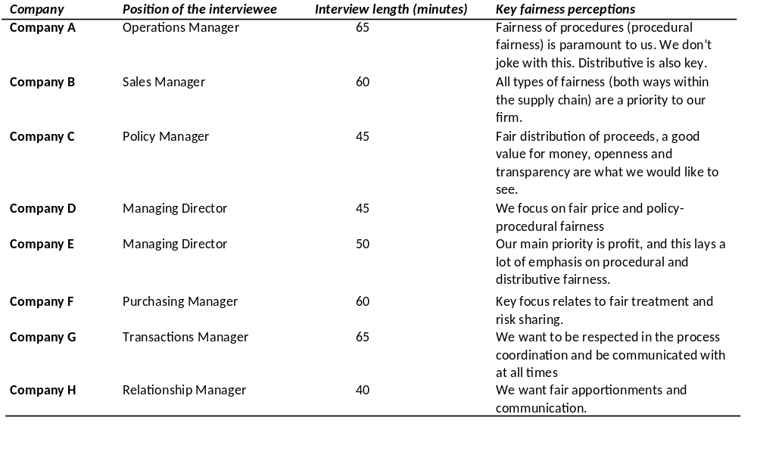
Findings

Slide 15
Findings
The concept of fairness
Our findings highlight the multi-dimensional nature of fairness as a concept in supply chain relationships.
The concept of fairness was mentioned continuously to be very subjective and personal to the individual perceiver/organization in the chain.
Although many firms elude from the discussion on fairness, we found that fairness is very vital for strong relationships between firms, particularly for relationships with a long-term focus.
Though fairness is interpreted according to the exact context that is being evaluated, the general consensus between the firms interviewed is that fairness relates to the justness of rationale for activities carried out between supply chain partners.
For instance, if a partner fails to perform a certain task that it would normally perform for the benefit of the relationship, fairness is keeping the other partner informed with adequate explanation of why it wouldn’t happen.
From a focal firm’s perspective, it entails treating other members the way you wish to be treated.

Slide 16
Findings
Determinants of fairness perception
We found that even though features such as age, educational level, gender, personality/value, and managerial style are elements that could impact on the way a manager (the firm representative) in the relationship perceives fairness, the most significant factor is the experience of the manager.
As explained by a Manager in Company A: ‘‘But experience is the absolute key because you remember things’’
We found that firm strategy, especially the strategy for administering relational exchanges as a vital element that influences how firms perceive fairness in supply chains relationship at the firm level.
Managers interviewed specifically accentuated that their firm values and corporate policy impacts a lot on their approach to relationships and their conducts during exchanges.
In a different view, a firm that has specified fair trade policy in its network or supply chain strategy would perceive fairness differently from a firm with little consideration for fair trade.
This point is explained by a Manager in Company E: ‘‘It also depends largely on the values set by individual companies towards fairness’’

Slide 17
Findings
Determinants of fairness perception
We also found that bargaining and purchasing power professed by firms will influence the perception of fairness at the supply chain level.
As explained by a Manager in Company H: ‘‘As the supplier, we will often feel inferior to the buyer because of the bargaining power that they possess’’
Likewise, we also found that the nature of the business environment where a firm operates can also impact on how fairness is perceived.

Slide 18
Findings
Fairness perceptions and collaborative activities
We found that when fairness is perceived by a focal firm in a relationship, it impacts on the level of communication (information sharing), investment and contribution towards the relationship (relationship investment), and determinations to collectively work with the partner (joint relationship effort).
Conversations with managers revealed that whilst the sense of fairness impacts on their collaboration through these activities, the impact could either be positive or adverse subject to the degree of perception.
For instance, if fairness is positively perceived based on the impartiality of a partner in areas of rewards allocation, decision and process enactment, and interactive conduct, their collaborative activities with the specific partner would be augmented and motivation to perform tasks excellently will be existent.
We also found that some companies are intolerant to the negative perception (unfairness) and may possibly discontinue their relationship with such partners depending on the degree of damage that the unfairness has caused them.

Slide 19
Findings
Reducing the difference in perception
Our findings indicate that firms perceive fairness differently depending on the specifics relating to their context in the assessment process.
We particularly identified that due to the several factors that affect the way firms perceive fairness such as the bargaining power of firm, firm strategy and value, anticipations from the relationship etc, the observation of fairness is a diverse subject to the circumstances attached to the specific perceiver.
For instance, if fairness is positively perceived based on the impartiality of a partner in areas of rewards allocation, decision and process enactment, and interactive conduct, their collaborative activities with the specific partner would be augmented and motivation to perform tasks excellently will be existent and commitment to the relationship would be exhibited.
We specifically found standard operating procedures to be a key mechanism that can minimize the dissimilarity in how supply chain partners perceive what is fair and what is not fair. Managers were particular about the necessity for a common understanding of the fairness outlook in their interactions and affairs with supply chain partners for a healthier relationship.

Slide 20
Conclusion
The findings of this research contribute to the ongoing investigations in supply chain relations by shedding light on the role of fairness.
Although fairness has been recognized as a formative means for reducing relationship damage and termination, our findings identify it to be a pre-requisite for an effective and valuable relationship for members of the supply chain.
Our study ascertains that the concept of fairness is personal and interpreted according to an individual firm’s peculiar situation or context.
Thus, due to the subjective nature of fairness and dissimilarity in its interpretation by members of the supply chain, it was found to have a key impact on the relationship between supply chain partners.
We were also able to conceptualise fairness as ‘‘the justness of rationale’’ in dealings between supply chain partners. i.e. treating people (and companies are people, supply chain is about people) the way you expect to be treated.

Slide 21
Conclusion
Recent studies that have examined fairness in the supply chain context have wholly considered one angle; its consequence mainly for indicators of an outstanding relationship, long-term orientation and performance.
We have considered the factors that influence the perception of fairness, finding that the determinants emanate from three main levels; individual, firm, environment.
This research provides new insights demonstrating that fairness is essential for building long lasting supply chain relationships that are equally valuable through key collaborative activities.
Hence, the findings of this research offer managers’ direction on how to manage their interactivities with their supply chain partners through the adoption of schemes that are able to effectively encourage fair practices during transactions.
Our findings particularly reveal that fairness is a concept that needs to be included in trading agreements and placed at the forefront of the relationship banner.

Slide 22
Future research
Our research was extremely exploratory in nature and we were only able to use eight interviews to have a clearer knowledge of the determinants of the perceptions of fairness for supply chain relations, and how the difference in perception between supply chain member can be reduced.
To be able to fully explore and capture the full representation on the determinants of fairness perceptions, we suggest for future research to conduct interviews on a larger scale to have a rigorous validation, deeper understanding and for clarification purpose.
By no means do we claim that all the factors identified as determinants of perceptions of fairness in buyer-supplier relationships are the only determinants. Future studies may also include other factors from the three main levels identified in this research.
Similarly, by no means do we say that all collaborative activities investigated in this study encompass a complete list of activities in collaborations. Other variables such as incentive alignment (Simatupang and Sridharan, 2005), conflict resolution (Griffith et al., 2006), and relational norms (Palmatier et al., 2007) may be investigated as factors that can be influenced by the perceptions of fairness.
Furthermore, we would also propose that future studies investigate the antecedents of fairness by collecting data from different industries to clarify whether industry type and competition are factors that influence how fairness is perceived.

Slide 23
References
Ellis, K.M., Reus, T.H. and Lamont, B.T. (2009) 'The effects of procedural and informational justice in the integration of related acquisitions', Strategic Management Journal, 30(2), pp. 137-161.
Griffith, D.A., Harvey, M.G. and Lusch, R.F. (2006) 'Social exchange in supply chain relationships: The resulting benefits of procedural and distributive justice', Journal of operations management, 24(2), pp. 85-98.
Hingley, M.K. (2005) 'Power to all our friends? Living with imbalance in supplier–retailer relationships', Industrial Marketing Management, 34(8), pp. 848-858.
Ireland, R.D. and Webb, J.W. (2007) 'A multi-theoretic perspective on trust and power in strategic supply chains', Journal of Operations Management, 25(2), pp. 482-497.
Johnson, J.P., Korsgaard, M.A. and Sapienza, H.J. (2002) 'Perceived fairness, decision control, and commitment in international joint venture management teams', Strategic Management Journal, 23(12), pp. 1141-1160.
Luo, Y. (2007) 'The Independent and Interactive Roles of Procedural, Distributive, and Interactional Justice in Strategic Alliances', The Academy of Management Journal, 50(3), pp. 644-664.
Nyaga, G.N., Whipple, J.M. and Lynch, D.F. (2010) 'Examining supply chain relationships: do buyer and supplier perspectives on collaborative relationships differ?', Journal of Operations Management, 28(2), pp. 101-114.

Slide 24
Thank You For Listening!

