Slide 1

Social capital in professionals' connections around digital support for children with DLD: beyond the Covid-19 crisis
Elspeth McCartney, University of
Stirling, UK (elspeth.mccartney@stir.ac.uk)
Joan Forbes, University of Stirling, UK
(j.c.forbes@stir.ac.uk)
Presented online at the 1st International Developmental Language
Disorder Research Conference (IDLDRC2021), 20-22 September
2021 - The DLD Project.

Slide 2

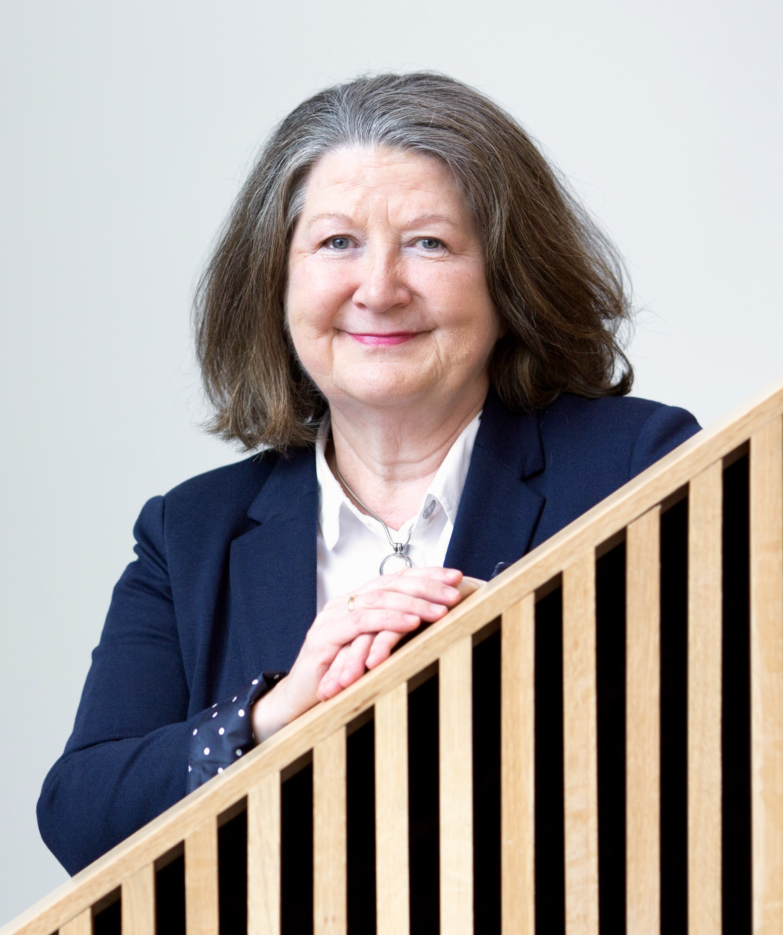
Professor
Elspeth McCartney
Professor
Joan Forbes

Slide 3
1 Background
School children with DLD require family engagement, and close co-professional working between schools and speech and language therapists/pathologists to provide effective support.
In Scotland, one of four UK nations, most SLTs work in a Health Board, part of the National Health Service (NHS). Most children attend non-selective local schools, run by a Local Authority (LA).
So large, separate, health and education organisations must work together so that children with DLD receive high-quality teaching and learning appropriate for all; and school-based language learning programmes; and individualised interventions, planned by an SLT and delivered directly by an SLT or indirectly by others, including teachers or school-based assistants.
This model is illustrated in the next slide (Ebbels et al., 2019)¹.

Slide 4
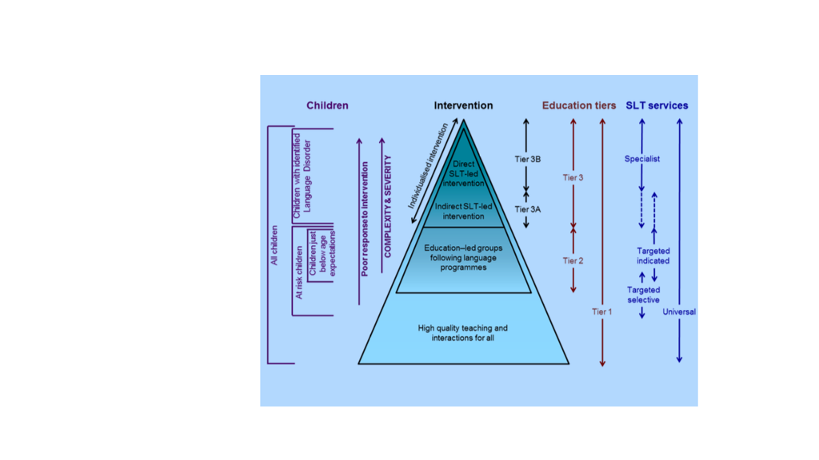
2 Model of service for children with DLD (Ebbels et al., 2019)

Slide 5
3 Social capital (SC) relations
Our previous work ²⁻⁷ has used social capital (SC) ideas based on those developed by Bourdieu ^{8,9} to analyse the co-professional working relationships that must develop between SLTs and teachers in implementing the tiered model.
Bourdieu’s SC model is next described, then applied to recent SLT and school service disruptions caused by COVID-19 precautions.

Slide 6
4 Types of social capital (SC)
Three types of social capital are discussed:
Bonding SC - strong work relationship within one's own professional discipline (here, amongst SLTs).
Bridging SC - strong relations connecting across to other professions
underpinned by appropriate intellectual capital (e.g. qualifications, knowledge and skills). In this presentation, bridging relations with teachers and other educational staff are considered.
Linking SC – good co-practice relations across professional groups' hierarchies, underpinned for example by cross-professional working groups; teams and other network structures, and forums set up to deliver coherent 'child at centre' services, to support change towards integrated services.

Slide 7
5 Levels of social capital relations
Successful co-working requires bonding, bridging and
linking capital developed at three organisational levels:
Macro-level – governance and policy level. This includes Scottish Government national policy for everyone; Health Board policy for SLTs, and Local Authority policy for schools and teachers.
Meso-level - institutional level, such as clinics, schools and nurseries
Micro-level – individual level, including practitioners' personal/individual knowledge and skills.

Slide 8
6 COVID-19 disruption
COVID-19 preventative measures suddenly disrupted child services:
most schools closed: children learned at home on-line, using materials constructed rapidly by teachers;
the IT equipment available in children's homes affected uptake;
many SLT services were unavailable, particularly face-to-face services.
Three information sources documented these disruptions:
a survey¹⁰ commissioned and published by the SLT professional body (the RCSLT) outlined disruption to SLT support for children across the UK;
an unpublished survey of children's services across Scotland by SLT leaders outlined problems due to digital incompatibilities
across homes, SLTs, and education services;
3. reports of rapid actions taken by an RCSLT Scotland officer to explain the problems to Scottish Government working parties set up to tackle digital problems.

Slide 9
7 The RCSLT survey
The RCSLT survey¹⁰ detailed problems across the UK.
414 responses were received on behalf of child clients aged 0-18 years (17% from Scotland). 26% of the total had been receiving SLT services for DLD or another language disorder.
For 335 of respondents, an SLT had cancelled appointments for 67%; 20% had received appointments online; 11% by phone, and 1% had cancelled their own appointments. Some support via printable or online resources was sent by SLTs for home use, but not quantified in the survey.
Reasons for these changes included closure of a premises (school, collegeor health centre) or redeployment of SLTs (some SLTs moved to intensive care units dealing with COVID-19 patients).

Slide 10
8 The RCSLT survey of child services cont'd.
School-based SLT services were routinely suspended even after schools reopened. Some children were supported online at home, others via teachers, and some lost SLT support completely.
The RCSLT survey also reported that phone and on-line SLT appointments were primarily used to communicate with a parent or carer, providing advice and support, but not direct intervention for a child.
Inequalities in home-based IT equipment and incompatibilities across public-sector IT systems caused poor communication, wasted time, and negative experiences for educators, SLTs, children and families.
The rapid commissioning and publication of this RCSLT survey demonstrated strong bonding social capital relations at macro (governance and policy) level with the UK professional body (RCSLT); also bonding relations within the SLT profession at institutional (clinic) and individual practitioner levels – amongst SLTs who read and responded to the survey.

Slide 11
9 Impacts of COVID on bridging
SC
However, the RCSLT survey¹⁰ also showed disruption and breaking of the habitual contacts and social capital relations that had developed between teachers and SLTs, which are needed to plan and deliver joined-up services. Child service users were abruptly cut off from their usual SLT support.
Bridging social capital relations between SLTs and education services that had previously existed may act as a protective factor and be rapidly re-established after the pandemic, re-instating previous SLT-school connectivity
But re-establishing previously good co-working SC resources and relationships will need conscious, focused, confident efforts built on mutual trust and confidence, in order to plan and re-design collaborative practice and collaborative service delivery.

Slide 12
10 The survey of digital problems
The second survey to be discussed was undertaken by SLT lead-practitioners from child services across Scotland (unpublished professional document).
This reported a list of barriers to digital co-working, related to IT policy and practices in and between health and education services
Key points included:
Remote digital working had been widely used and valuable, and will be used in the future, accelerated by the demands of the pandemic.
However, lack of shared networks and practice norms across health and education digital and technical resources and IT policy limits co-working, resulting in unequal service provision for different children.

Slide 13
11 The survey of digital problems cont'd.
Coherent national governance and policy level SC changes across child services are needed to resolve technical and digital-related problems. Problems to be solved include:
platforms that are accepted by some, but not all health or education services;
differences between education and health services’ IT systems and equipment;
difficulties in sharing reports recording children’s needs;
variation in acceptability by different services of contact using social media;
technical difficulties in sending large video files or pre-recoded talks due to capacity limits;
security concerns about sharing child information confidentially on-line, and indeed agreeing which platforms are secure;
difficulties for SLTs in securing technical support and up-to- date IT equipment.

Slide 14
12 The impact on bridging and linking social capital
Difficulties in transferring information (such as sharing details of child assessments/progress) was an effect of inadequate existing SC relations across child sector services around producing coherent IT networks, norms and trust/confidence relations.
Cross-organisation IT and inter-personal network breakdowns and difficulties adversely impacted opportunities for strengthening and building-up bridging SC relations (i.e. shared knowledge and skills) between SLTs and education services.
Using and building-up linking social capital resources (I.e. connections to/from higher and lower organisational levels) was adversely affected. Safe and secure on-line contact could not be made across or up and down between health and education service levels.

Slide 15
13 Using the surveys' results
Results of the RCSLT survey and the SLT child leads’ survey were passed to an RCSLT (Scotland) national officer, using powerful within-SLT-profession bonding SC.
This officer used her existing high-level stocks of bridging (across professions) and linking (up/down other institutions) social capital to share both survey's results with relevant health and education decision makers; 'third sector' (i.e. charity) officers; and a Scottish Government working group set up to develop the digital future across public services in Scotland.
A strategic leader within this working group used it across governance and policy levels, to inform the content of a new Scottish government policy document¹¹.
Existing linking social capital connections were thus employed at all levels to disseminate to partners and decision-makers.

Slide 16
14 Summary
Effective use of existing co-professional SC helped survey and identify IT-related gaps, with opportunities identified for changes and new developments in child agencies' co-working. Notably, dissemination of two SLT surveys succeeded in developing linking SC.
However, inter-agency communication processes lacked an established structure, and were inherently uncertain and unstable. Analysis showed the need for built-in, strong, and resilient embedded forms of bridging and linking social networks macro, meso and micro levels: governance, institutional, inter-professional and across to families.
The SC analysis identified that new IT-related connections are needed across child services to ameliorate digital challenges.
Analysis also highlighted that effective within-SLT bonding SC was required, and, crucially, high stocks of cross-agencies' bridging and linking SC needed to be designed-in and strongly built-up to create more resilient child centred co-practice structures and systems.
Non IT-related shared knowledge and skills relations of trust and confidence, based on shared networks and co-practice norms, also need to be built-up and embedded for future sector resilience.

Slide 17
15 Conclusions
This presentation has described rapid and effective mobilisation by SLTs to identify COVID-19 related disruptions using survey methods, and to disseminate information to Government and other decision-making bodies.
However, COVID-19 disruption to services for children with DLD and other language needs was severe, made worse by inadequate IT within and across SLT and education services;
Therefore cross-networks SC disruptions resulted, with communications non-existent or showing major gaps and response breakdowns, with confidence in co-practice norms and networks therefore lost.
If the tiered model of service introduced at the start of this presentation is to operate for the benefit of children with DLD, good co-professional working, underpinned by trust and confident engagement, must be sustained and activated at all levels post-Covid-19.
Children with DLD and their families require to be put at the centre of coherent, stable and reliable co-professional practice.
The need swiftly to re-design and build stronger, more certain, more stable bridging social capital across professions, particularly between SLTs and teachers/education staff, is clear.

Slide 18
16 Conclusions cont'd.
Applying Bourdieusian SC 'thinking tools' will continue to highlight, inform, and aid new insights and understandings of processes central to creating unified, coherent, ordered and stabilised cross-child sector IT services.
Social capital theory, applied in this small study, has offered tools needed to focus on relations (here, co-work relations).
Applying SC theory will also, for example:
  encourage joined-up critical reflection on IT and interprofessional connections and disconnections;
  reveal cross-sector IT systems gaps and incoherencies;
  inform IT (and other) connectivity re-design decisions;
  and indicate where coherent coordinated processes and action post-Covid-19 would benefit all child sector users.
Thank you

Slide 19
17 References
1. Ebbels, S.H., McCartney, E., Slonims, V., Dockrell, J. E., Norbury, C. F. (2019). Evidence-based pathways to intervention for children with language disorders. International Journal of Language and Communication Disorders, 54 (1), 3-19.
2. Forbes, J. & McCartney, E. (2010). Social capital theory: a cross-cutting analytic for teacher/therapist work in integrating children’s services? Child Language, Teaching and Therapy, 26, 3, 321-334.
3. Forbes, J. & McCartney, E. (2012a). Changing children’s services: a social capital analysis. In M. Hill, G. Head, A. Lockyer, B. Reid & R. Taylor (eds.) Children’s Services: Working Together. Harlow: Pearson, pp. 275-287.
4. Forbes, J. & McCartney, E. (2012b). Leadership distribution culturally? Education/speech and language therapy social capital in schools and children’s services. International Journal of Leadership in Education: Theory and Practice, 15 (3), 271-287.
5. Forbes, J. & McCartney, E. (2015). Educating child practitioners: a (re)turn to the university disciplines. Discourse: Studies in the Cultural Politics of Education, 36 (1), 144-159.
6. McKean C, Law J, Laing K, Cockerill M, Allon-Smith J, McCartney E et al. (2017). A qualitative case study in the social capital of co-professional collaborative co-practice for children with speech, language and communication needs. International Journal of Language and Communication Disorders, 52(4), 514-527.
7. Forbes, J. & McCartney, E. (2015). Educating child practitioners: a (re)turn to the university disciplines. Discourse: Studies in the Cultural Politics of Education, 36 (1), 144-159.
8. Bourdieu, P. (1984) Distinction. A social critique of the judgement of taste. London. Routledge.
9. Bourdieu, P. (1986) The forms of capital. In J.G. Richardson (ed.) Handbook of theory and research for the sociology of education (pp. 241-258). New York: Greenwood.
10. Clegg, J., O’Flynn, P., Just, P. (2021) Speech and language therapy during and beyond COVID-19: building back better with people who have communication and swallowing needs. London: RCSLT.
11. Scottish Government (2018, refreshed 2020). Scotland’s Digital Health & Care Strategy. www.gov.scot
12. Rawolle, S. & Lingard, B. (2013). Bourdieu and Educational Research: Thinking tools, relational thinking, beyond epistemological innocence. In Murphy, M. (Ed.) Social Theory and Education Research: Understanding Foucault, Habermas, Bourdieu and Derrida. London: Routledge.

