Slide 1
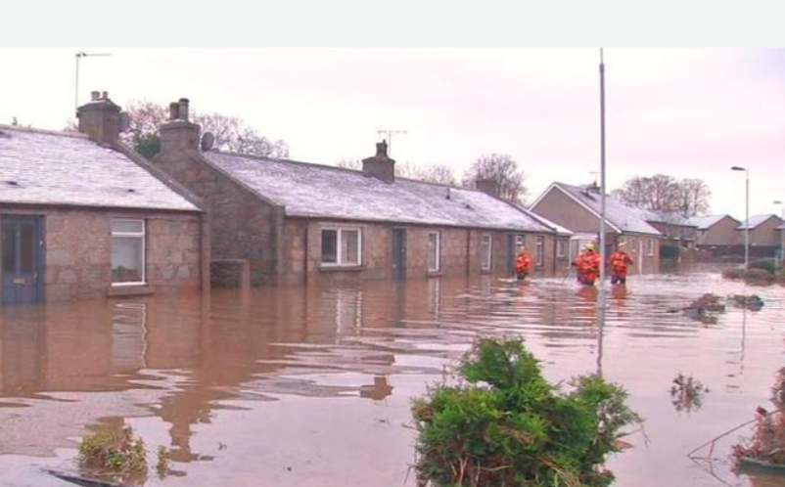
‘What I’d really like to do is to bring them here and give them a piece of my mind’:
Rethinking Expectations of ‘Solutions’ in Applied-Action Disaster Research
Dr. Irena Leisbet Ceridwen Connon,
University of Dundee & University of Stirling
Email: i.l.c.connon@dundee.ac.uk

Slide 2
Flooding and Extreme Weather in Scotland: Contested Responses and Imperfect Solutions
‘That’s two years in a row we had this awful flooding and each time someone comes along and says we need to do such and such differently and all will be well…..[B]ut nobody tells us what it is we need to do.’ (Jane, 2016)
‘Each time we are told we should so something. Its always us, we’re at fault. Even when they praise us for doing what they should be doing. Resilient communities they say. We’re resilient alright. Resilient to their [the Government’s] damn inaction. They need to do something!’(Keith, 2017)
‘What we want are solutions; good workable solutions.’ (Emergency responder 2017)
‘We ask what they need, but the responses are vague and then we’re hit with complaints. If you can tell us what it is, we’ll do it.’ (Scottish and Southern Energy Networks representative 2015).

Slide 3
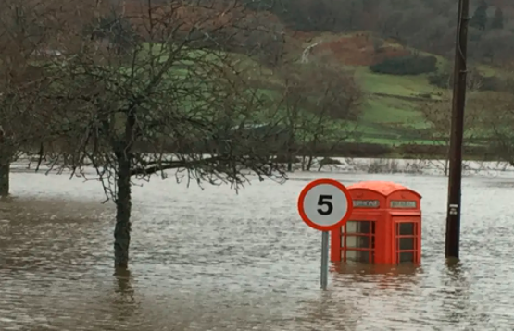
Research for Impact: Raising Expectations
Knowledge Transfer Partnership (KTP) projects and Impact-Based Applied Action research projects: Emphasis on ‘providing real-world solutions to real-world problems.’
Focus on outcomes, ends and ‘measurable’ impacts
Reflective of dominant, western scientific knowledge systems; create conditions for research
Creates expectations for all parties
Places the researcher in a unique role within a complex network of relations

Slide 4
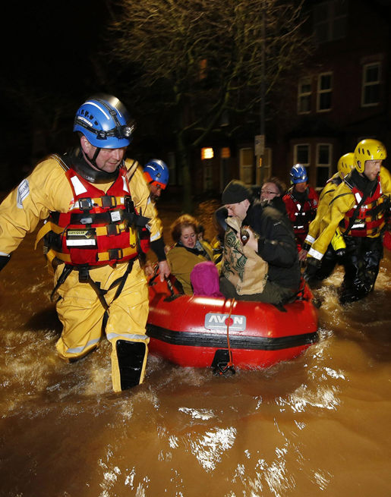
Dilemma 1:
Navigating Complex Local Political and Cultural Divides
Meeting heightened expectations mixed with caution and doubt
‘We didn’t know who you were or not really anything about you….aye, we knew what you were doing and all that, but you, as in you yourself, what kind of character you were and all, that we didn’t know. You seemed an alright kind of lass, but its that whole who you were and who you stood with. We wanted more about you first’
  (Brian in 2016 talking about meeting me in 2014 on my first visit to the local area)

Slide 5
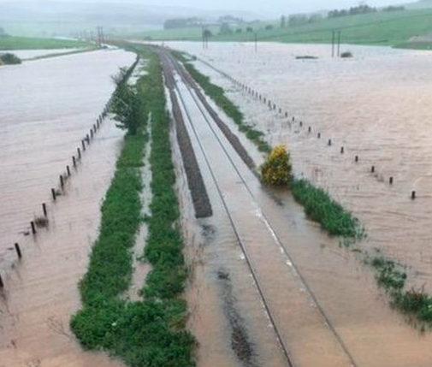
Dilemma 2: The Catch 22 of Care in the Post Flood Aftermath in Rural Scotland
Care is a complex, culturally-specific concept and practice
Local meanings and practices of care differ from those used in dominant institutional discourses
Expectations surrounding ‘care’ and ‘caring’ are highly socio-politically charged
Caught in a Catch 22: Navigation of an official politics of ‘care’, a local politics of ‘caring’, and the complex intersection of the two.

Slide 6
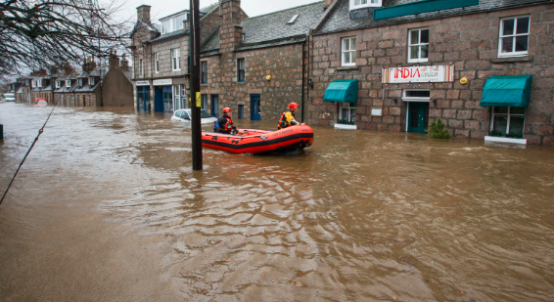
Dilemma 3: Contesting Contested Solutions
Justice for Whom, By Whom? Impact for Whom?
‘It’s the talking which is what really helps. Some of these things, I hadn’t thought of before. It makes a difference once you know. But when no one is saying anything, nobody’s talking, then nothing gets done.’ (Margaret 2015)
‘I had no idea about that. We don’t really hear about all that; we don’t get told…..that’s helpful to know.’ (Local Authority Representative 2015)
It’s that difference between listening and really listening, and doing things properly, it’ll take time. It’ll take time because its not a quick fix.’ (Jim 2015)

Slide 7
Conclusion
The predominant focus on the ‘tangible ends and outcomes’ within applied-action research is especially problematic in the disaster and humanitarian context
Creates insurmountable burdens on the researcher
Creates expectations amongst interlocutors that cannot be met: Can potentially be highly damaging for all involved
Reflects and heightens cultural dominance and unequal power relations
Yet, navigating ethical and practical dilemmas in these field can create new opportunities that enable community members to exercise their own voices and agency and introduce opportunities for careful, critical reflection amongst all parties.

