Slide 1
Comparing International Models of Social Care
Considerations for Social Care Delivery, Sustainability and Funding in Scotland
Dr Irena L. C. Connon
Email: irena.connon1@stir.ac.uk or irenaconnon31@gmail.com

Slide 2
Aims and Structure
The aims of this presentation are:
1. To provide an overview of the Rapid Literature Review of International Models of Social Care
2. To outline the key findings from the review
3. To provide a series of evidence-informed recommendations for decision-makers

Slide 3

Literature Review of International Models of Social Care
Purpose: To provide a descriptive and comparative overview of the relevant literature available to help inform decision-makers
The review considered:
1) How social care is structured, delivered, funded and governed in each country,
2) Benefits and limitations associated with each model,
3) Impacts on population health outcomes,
4) Enablers and barriers to the effective implementation and delivery of each model,
5) Enablers and barriers to the long-term sustainability of each model,
6) Important points to consider when thinking about the transferability of the models for implementation in Scotland.

Slide 4
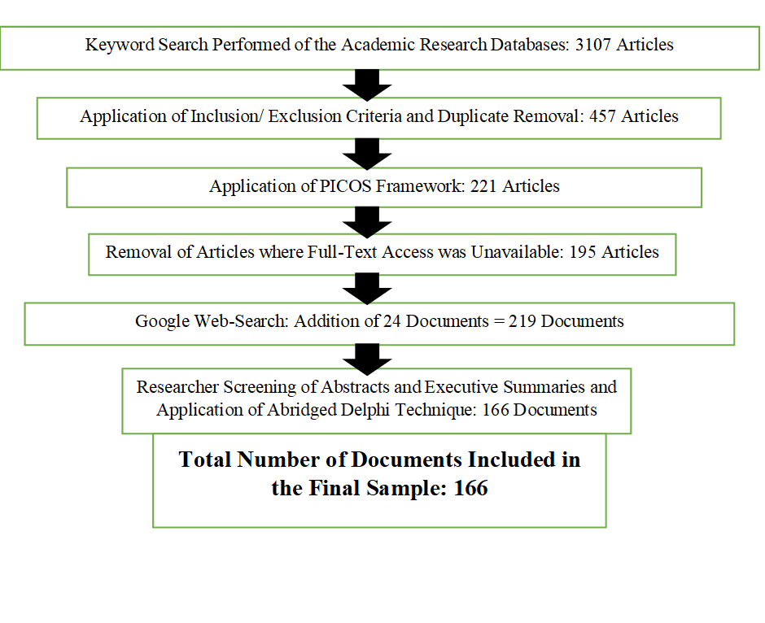
Methodology
The rapid review of the literature combined systematic with narrative and abridged Delphi Method techniques to review the existing literature
Research questions was determined by the aims of the review
The data collection and quality check process is outlined on the flow chart opposite
Analysis and coding of the 166 articles included in the final sample was undertaken using qualitative descriptive analysis

Slide 5
Findings 1: Social Care Funding, Delivery, Structure and Governance
Model | Delivery | Governance | Funding
Australia | Services are provided by a mix of public, private for-profit and private not-for-profit services. | State governments are responsible for the provision of health services, but welfare service is a federal responsibility. | Tax revenue and user Charges. User charges are means tested
United States | Mostly delivered by for-profit providers. | Decentralized approach where governments provide incentives | Private funding by Individuals. Social care costs are not covered by Medicaid
Alaska | Eligibility determined by financial need. Special programs provide care to Indigenous Alaskans. | Administered by the Alaska Department of Health and Social Services Division of Public Assistance. | Alaska has its own version of Medicaid, which covers some health-related costs associated with home care
Canada | Mix of public, private for-profit and private not-for-profit providers. | Social care comes under provincial jurisdiction and is considered an extended health service, provided at provincial discretion. | Provincial governments cover part of the cost. The Federal Parliament relies on spending power inferred from the Canada Health Act to transfer funds to the provinces.

Slide 6
Findings 1 Continued….
Model | Delivery | Governance | Funding
Japan | Provides a basic level of universal care, with high levels of expectations placed on informal carers. | Municipalities operate the public long-term care insurance system and are responsibility for planning long-term care in each jurisdiction. | Consists of a mandatory social insurance scheme. Half the revenue comes from general taxation, with the rest coming from premiums and user co-payments.
EU Countries (Netherlands, Germany, and France) | In Germany, most formal social care is delivered by private providers. In France, over half are publicly owned. People insured under the Dutch can choose between benefits in cash & in-kind services. High levels of care are provided by informal carers. | Federal authorities are responsible for providing the infrastructure for social care in Germany. Care services are administered by health insurers, but the care funds are independent self-governing bodies. | In the Netherlands and Germany, mandatory social care insurance schemes are funded by general taxation at central government level. In France, it is funded by taxation at central and regional government levels.
Switzerland | Professional care is delivered by a range of providers. | Responsibilities divided between the federal, cantonal and local levels. | Financed from contributions from taxation and a compulsory health insurance system. High personal contributions.

Slide 7
Findings 1 Continued….
Model | Delivery | Governance | Funding
Nordic Models (Sweden, Finland, Denmark, Norway) | Since the 1990s, changes in policy have transformed service delivery into a more hybrid public-private approach. | Local authorities have the freedom to organise care delivery, but the system is supported by national level legislation. | The state and local authorities heavily subsidise care services, financed through income and local taxes.
New Zealand | Care service provision is subject to a needs assessment and the health ministry funds and purchases care. Primary health organisations contract with district health boards to provide a range of primary and community services | From 1 July 2022, Te Whatu Ora - Health New Zealand has taken over responsibility for planning and commissioning hospital, primary and community health services. | Social care services are part of a health board’s allocation, funded through tax revenue.
UK Countries (Scotland, England, Wales, and Northern Ireland) | Northern Ireland operates an integrated structure of health and social care. Adult social care in England has greater private and voluntary sector provision. Northern Ireland’s services are commissioned by the Health and Social Care Board. | Local authorities in Scotland, England and Wales are responsible for social care. They work with health boards to plan and commission local community-based health and social care services using funds from the local authority and health board. The Department of Health in Northern Ireland is responsible for social care. | Each of the four National Health Services are funded primarily from general taxation gathered at a UK level. Funds are distributed to the devolved governments through the Barnett formula.

Slide 8
Key Differences in Social Care Funding, Delivery, Structure and Governance
Model | Funding | Locus of Control | Eligibility | Integration of Health and Social Care | Informal Care Expectation
Australia | Central | Central | Needs; Means-tested | Separate | Low
US | Central | Central | Means | Separate | Mix
Alaska | State | State | Means | Separate | Mix
Canada | Provincial | Provincial | Needs; Means | Extended health care | Low
Japan | Municipal | Municipal | Eligibility; Means | Separate | High
EU Countries | Central (France – combined) | Central/ Mix | Eligibility; | Separate | High
Switzerland | Central | Mix | Eligibility & subsidies | Linked | Low
Nordic Countries | Central | Largely central | Universal; Eligibility | Separate | Low
New Zealand | Central | Largely central | Need | Integrated | Low
UK Countries | Central | Mix | Needs; Means | Integration (Integrated in N. Ireland) | Low

Slide 9
Findings 2: Key Strengths and Weaknesses of the Different Social Care Models
1. Australia
  Opening of care provision to private providers has led to increasing inequalities,
  Lack of integration negatively impacts care delivery for users with complex needs,
  Reduced need for informal care.
2. United States
  Inequalities in access to aged care; exacerbation of socio-economic and racial health inequalities,
3. Alaska
  Aimed at ageing in place,
  Potential for reducing inequalities in outcomes,
  Built upon diversity, rather than simply recognizing diversity,
  Primarily health-focused.

Slide 10
Findings 2 Continued…
4. Canada
  The majority of long-term social care is provided in residential institutions;
  Differences in provincial arrangements creates inequalities between provinces,
  Strict regulations for the licensing of residential homes helps private-for-profit providers meet care delivery standards.
5. Japan
  Medical-model based; Paternalistic,
  High levels of informal care is a gender equality issue,
  Access is standardised.
6. EU Countries
  Basic level of care only, with the rest expected to be covered by informal care provision,
  Single-sourced insurance-based systems are vulnerable to macroeconomic fluctuations,
  Contribution-based systems can result in reduced need for political bargaining.

Slide 11
Findings 2 Continued…
7. Switzerland
  Ranks well internationally,
  Fragmentation of governance and delivery is associated with increased risk of sub-optimal quality of care.
8. Nordic Countries
  Universal coverage; ‘best practice’ by international standards,
  The system is supported by national level legislation which ensures equality of levels of care service provision and quality of services.
  Marketisation has challenged the principle of universalism through the introduction of options to pay for additional services.
9. New Zealand
  Integration helps address the care needs of those with complex needs,
  Emphasis on addressing overall wellbeing,
  Focused on addressing existing health and social inequalities.

Slide 12
Pros and Cons of the Existing Models in Each of the UK Countries
Scotland:
Increased integration has potential for a more holistic approach to care provision,
However, health can emerge as the dominant partner,
Public expectation for social care provision,
Eligibility is relatively high.
Northern Ireland:
Multiple layers of decision-making and unclear lines of accountability,
Care user choices can be limited.
England
  Slightly greater reliance on for-profit care providers
  Lack of statutory basis for integration,
  Satisfaction with social care has been decreasing in recent years.
Wales
  Concerns over accessibility, care quality and coordination,
  Pooled budgets help facilitate data sharing and joint commissioning.

Slide 13
Findings 3: Impacts of Each Model on Population Health Outcomes
Model | Linked Health Outcomes
Australia | Lack of integration between health and social care providers negatively impacts delivery of care for users with complex care needs.
US | The US model is associated with widening health inequalities.
Alaska | Social care programs for Indigenous Alaskans are associated with reductions in hospital visits and improved prevention and treatment of chronic disease
Canada | Differences in provincial arrangements result in unequal care distribution at national level. Health outcomes lag behind other high-income countries.
Japan | Linked to improving quality of life outcomes for those with complex needs and disabilities.
EU Countries | Demand for personal budgets is high and the system has struggled to cover costs resulting in long waiting lists and unmet care needs.
Switzerland | Internationally, the Swiss system ranks well regarding quality of care, access, efficiency, equity, and promotion of healthy lives.
Nordic Countries | Increased marketisation of care is linked to widening health inequalities.
New Zealand | Integration is associated with improved mental health and quality of life for those with complex needs. Integrated care provision has helped address health inequalities between Indigenous people and other New Zealand citizens.
UK Countries | Increasing integration has had a relatively limited effect on reducing existing health inequalities to date.

Slide 14
Questions for Reflection
Underpinning questions over integrated care are fundamental questions about how health-related care relates to social care.
Consider:
  How social care needs reflect: a) health needs & b) quality of life needs (overall wellbeing)?
  With this in mind, which model(s) do you favour?

Slide 15
Findings 4: Barriers and Enablers of the Success of Different Models of Integrated Care
Australia
Limitations in access to services in certain geographic areas can hamper efforts
New Zealand
Having a clear vision of a ‘one system, one budget’ approach is important for achieving positive outcomes.
Switzerland
Quality indicators and legal clarification about the responsibilities is required,

Slide 16
Findings 4 Continued…
Germany, France and The Netherlands
Enablers of improvement included interprofessional meetings and improved communication.
Canada
Provincial amalgamation of district health authorities into a single provincial health authority helped improve outcomes,
Frameworks and standards may help facilitate successful integration,
Quality, not finance, needs to be the driving force behind integration if it is to prove to be successful in practice in improving access and quality of care.
Alaska
Structural integration is key to success,
The Alaskan models are largely primary care systems.
United States
The ability of reforms to improve outcomes and generate reserves – whether public or private – is dependent on the broader economic situation

Slide 17
Findings 5: Challenges to the Sustainability of Existing Social Care Models
Model | Challenges to Long-Term Financial Sustainability
Australia | Financial instability; ageing population and changing patterns of care needs
US | Increasing health inequalities; sustainability of the model is dependent on the wider economy
Alaska | Financial sustainability is dependent on the wider economy.
Canada | Ageing population; changing patterns of care needs; short political cycles (2-4 years) may affect the potential of funding reforms.
Japan | Rapid growth of ageing population
EU Countries | Population ageing; vulnerability to economic fluctuations; Dissatisfaction with familial care expectations
Switzerland | Populating ageing and increasing burden on municipalities
Nordic Countries | Universality of future provision is increasingly questioned given the ageing population
New Zealand | Dependent on increased spending on community-based services
UK Countries | Ageing populations and growing health inequalities

Slide 18
Findings 6: Factors to Consider when Thinking About Transferring One Social Care Model to a Different Context
Lessons learned:
In practice, it can be difficult to transfer one model from one context to another,
The abilities of a model to financially succeed is dependent on the wider economy,
There is a need to consider fundamental principles that underpin a country’s model of social care.
Important factors to consider:
The rate of population ageing in both countries,
Population geography and governance structures,
Projected levels of health and income inequality,
Population diversity.

Slide 19
Conclusions
There are strengths and limitations to each model. There is no ‘perfect’ model.
All social care systems are facing pressure due to population ageing,
Integration can help deliver more holistic approaches to care, but strategies need to be put in place to ensure that social care does not end up in a subordinate position to that of health care.
Delivering savings should not be adopted as an immediate objective of integration,
Stricter demands for eligibility risk increasing reliance on informal care and widening inequalities in health and quality of life.

Slide 20
10 Recommendations for Decision-Makers
1. Care services should be provided on a consistent basis across all geographic areas.
2. Policy should address existing structural inequalities to enable the care system to achieve its maximum potential.
3. A clear ‘one system, one budget’ approach would reduce complexity.
4. An integrated care service should be substantially publicly funded so that use of privately funded services does not become more unevenly distributed.
5. Eligibility for access to social care services should remain high to prevent rising inequalities, unmet needs and increased dependency on informal care providers.
6. A standardised definition of what ‘personalisation’ of care means should be developed.
7. Mechanisms that address cultural differences between locally accountable social care services and centralised health services should help improve integration.
8. Budgets intended to support integrated care should not be used to offset overspends in acute care.
9. Financial savings should not be viewed an immediate objective of integration.
10. Forward planning and significant investment are required to meet future care needs.

