Slide 1
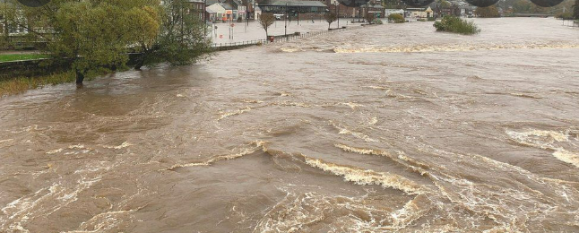

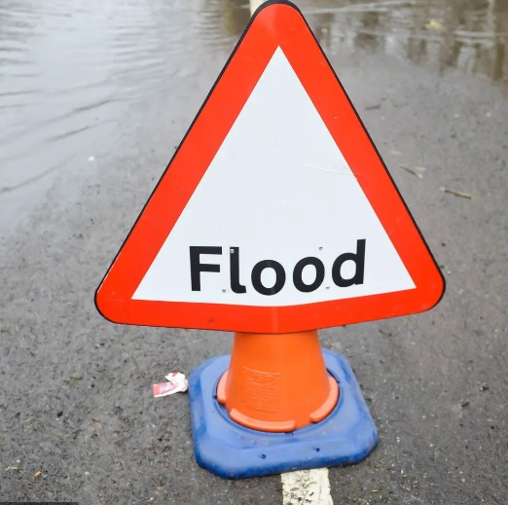
'Don't lose heart in dark times, we can't keep going in the same direction forever’:
Culture and a Compound of Covid and Climate as Catalysts for Change in Responding to Extreme Weather in Scotland
Irena Leisbet Ceridwen Connon,
University of Stirling and The University of Dundee
Email: irena.connon1@stir.ac.uk or i.l.c.connon@dundee.ac.uk

Slide 2
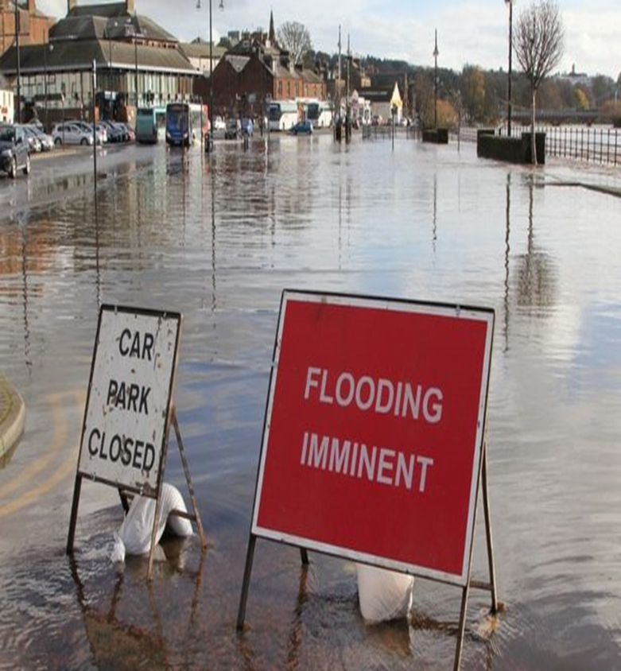
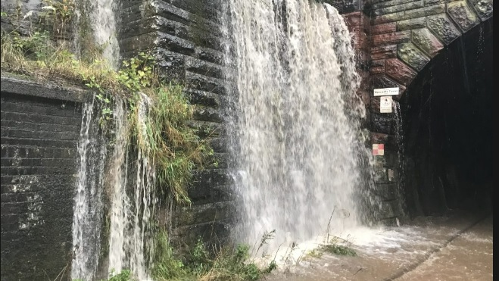
Culture and Confronting Compounded Crises
Local responses to extreme weather pre-pandemic
Responses to the first wave of the Covid-19 pandemic
Culture and collective local responses to storm-related emergencies during the second wave of the Covid-19 pandemic

Slide 3
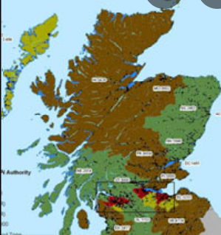
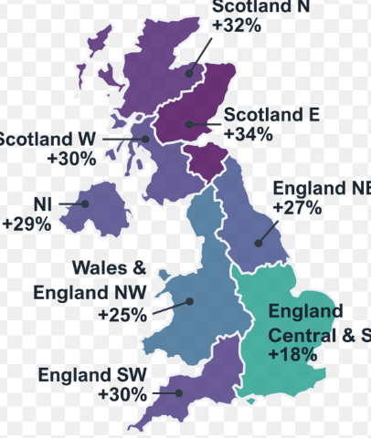
Local Responses to Increasing Frequency and Severity of Extreme Weather: Pre-Pandemic
“What sets us apart? Round here, we know the land, we know the weather. It’s part of who we are, part of growing up round here”
“You cannae mak sense o’ it the way you used tae. A’hing changing too much and too quick noo”

Slide 4
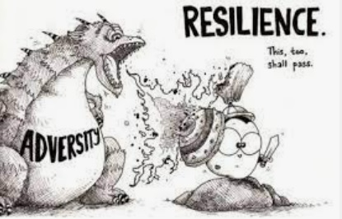
Culture hijack and speaking multiple languages of resilience and vulnerability
2014: Local meanings of resilience:
‘Well we are resilient round here. We’re tough and we keep going. Survivors, oh yes. Survival. Keep going to the end. That’s us and we’re proud of it’
2016: Official definitions of community resilience:
‘Ability to ‘bounce back” after being hit by an emergency or disruptive challenge.’ & ‘the capacity of an individual, community or system to adapt in order to sustain an acceptable level of functioning’.
2019: Local views on the concept of resilience:
‘It’s a word we don’t use here any more. It’s a dirty word. In a way it’s a shame as its very much part of our culture, but they [Scottish Government] have made into something else and we’re now ashamed of it.’

Slide 5
Culture and Responses to the COVID 19 Pandemic
‘A’body keeps a look out for a’body else. Naebody’s left behind see. You’re looking for whit’s wrong, but you’re looking for whit you cannae really see until you look hard enough…..cannae do that if you don’t see folk.’
‘I’m old and they say it’s about protecting the old. Young people are sacrificing so much for us. That’s not right. I’m at the end of my time, they are the future. That future’s not going to happen if their lives are stuck on hold.’

Slide 6
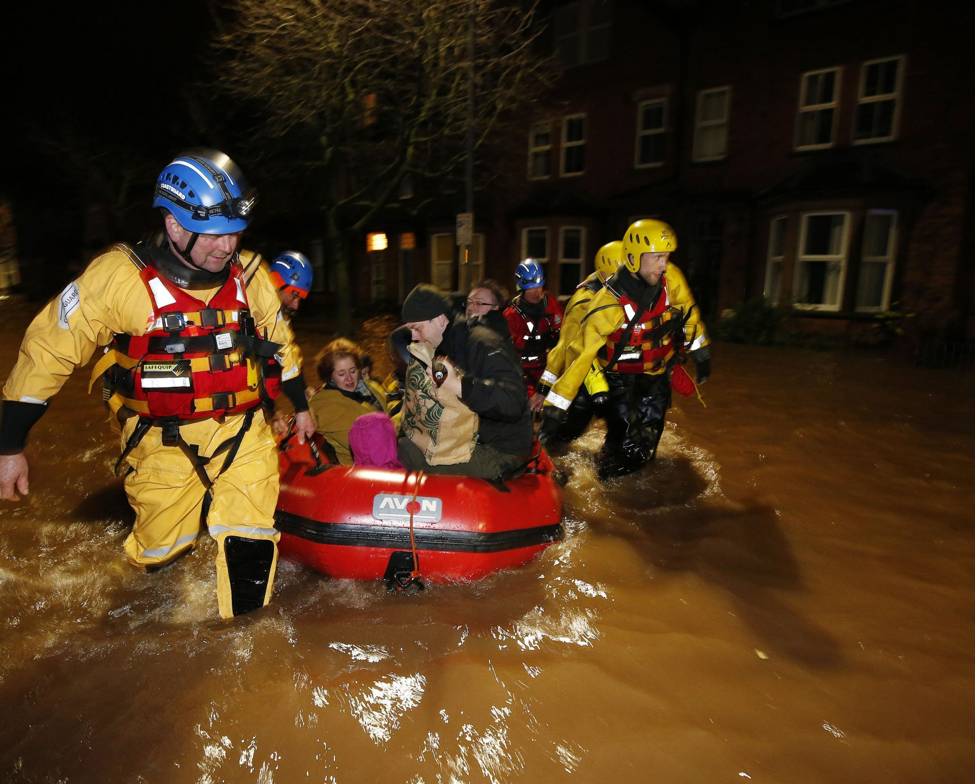
Flooding during the first wave of the Covid-19 Pandemic: Compounded Crises and Compounded Sense of Local Collectivity
Dual approach for seeking out and offering help
Enhanced sympathy for those deemed ‘outsiders’
‘Outsiders’ deemed as ‘insiders’ and as part of the local landscape.
Crisis in capacity to adapt to flooding using known strategies and emerging new crisis: enhanced sense of equality at being at the mercy of events.

Slide 7
Reconsidering and Repackaging Unspoken Concepts
2021 Local meaning of resilience:
‘It’s surviving, but its surviving our way…..our way but together. All of us. Round here we are resilient. We shouldn’t deny it. We are strong. But we don’t bounce back. We just don’t let go. We keep on going….. want to go forward together…..We don’t want people to think we are excluding them or saying we are that different.’

Slide 8
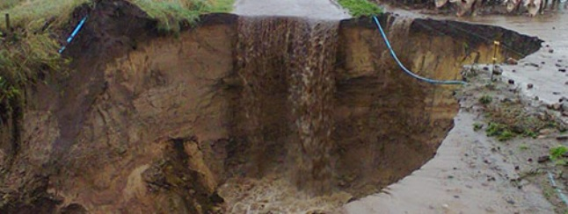
Culture and Changing Responses to Consecutive Extreme Weather Events
‘It’s a lang road that’s no goat a turnin’, meaning ‘ don’t lose heart in dark times, things can’t keep going in the same direction forever’… Nor should they. And things were different this time. More trust from everybody.’

Slide 9
Conclusion
The case of rural Scotland here shows the importance of culture for devising new ways of responding to risk within contexts of uncertainty and compounded crises.
Culture is adaptive and fluid and provides the means for creativity in finding solutions to enhance coping abilities and adaptation: culture is not static.
It also highlights problems associated with the hegemonic uses of the concepts of resilience and vulnerability which continues to dominate official policy concerning climate-change, civil emergencies, disasters, as well as much of the wider climate change, public health, and risk and disaster research.
Attachments to landscape (including weather) and other people contrasts with dominant western narrative of human-environmental relationships: Shows diversity of understanding and responding to weather and other disasters at the sub-national scale driven by cultural differences.

